Slide 1
MEAL it
Alaap Bharadwaj – Requirements Lead
Fahmida Joyti – Configuration Lead
Xiaohang Lin – QA Lead
Jingtong Song – Security Lead
David Vanderschaaf – Project Lead
Wenxiao Zhou – Design Implementation Lead

Slide 2
Agenda
Technology Stack Overview
Architecture
Database Design
Deployment
Demo

Slide 3






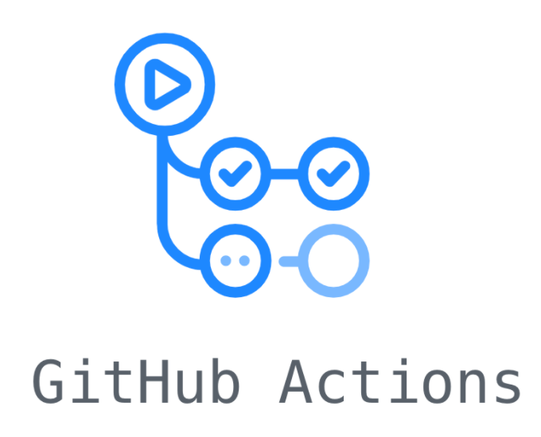

Development Stack Overview

Slide 4
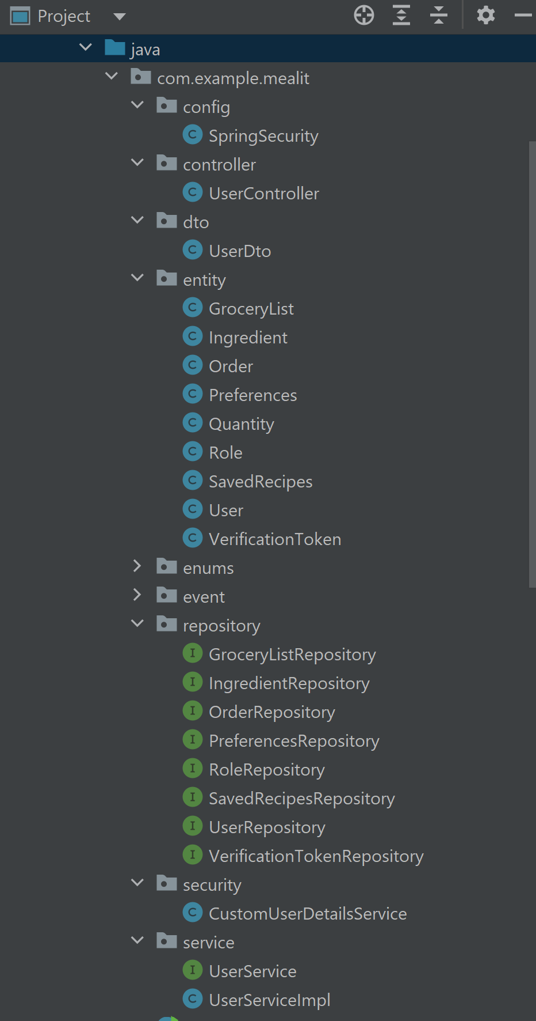
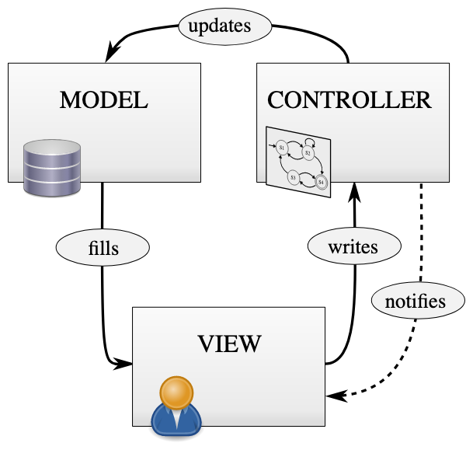
Architecture

Slide 5
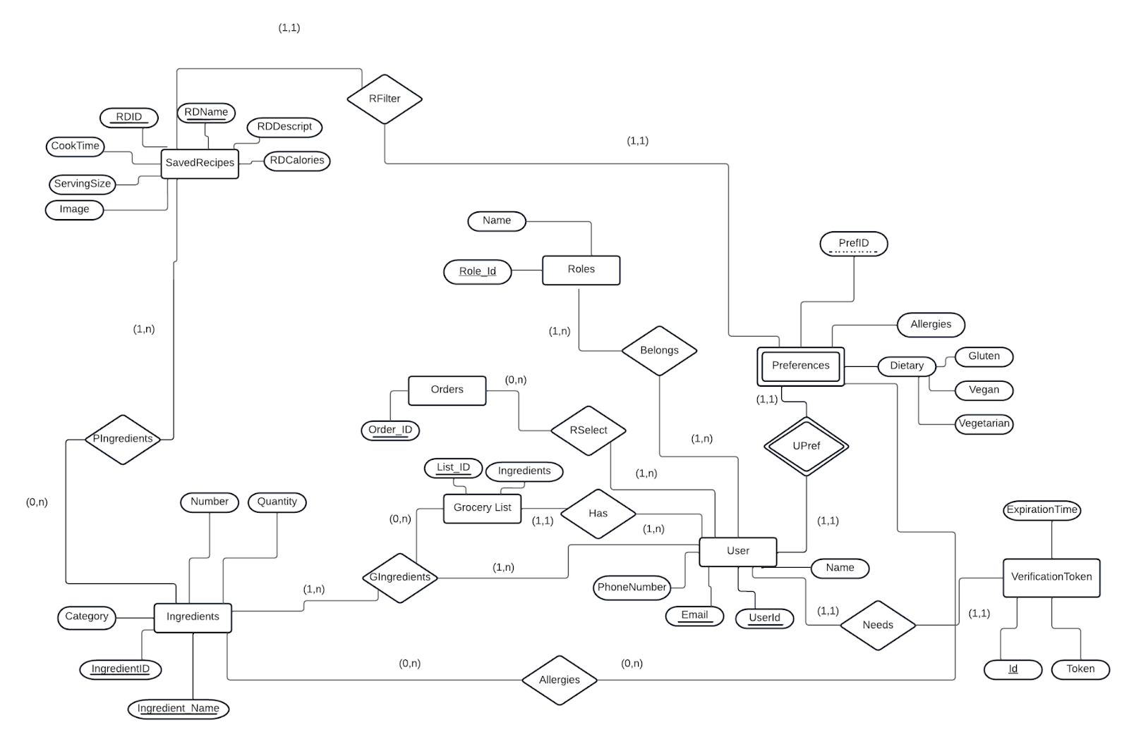
Database Design
Notes:
User has orders(one to many relationships), grocery lists(one to many relationships), user has preferences(one to one relationship), roles(one to many), verification token(one to one), recipe has ingredients(many to many relationships), grocery list has ingredients(many to many relationship) .

Slide 6
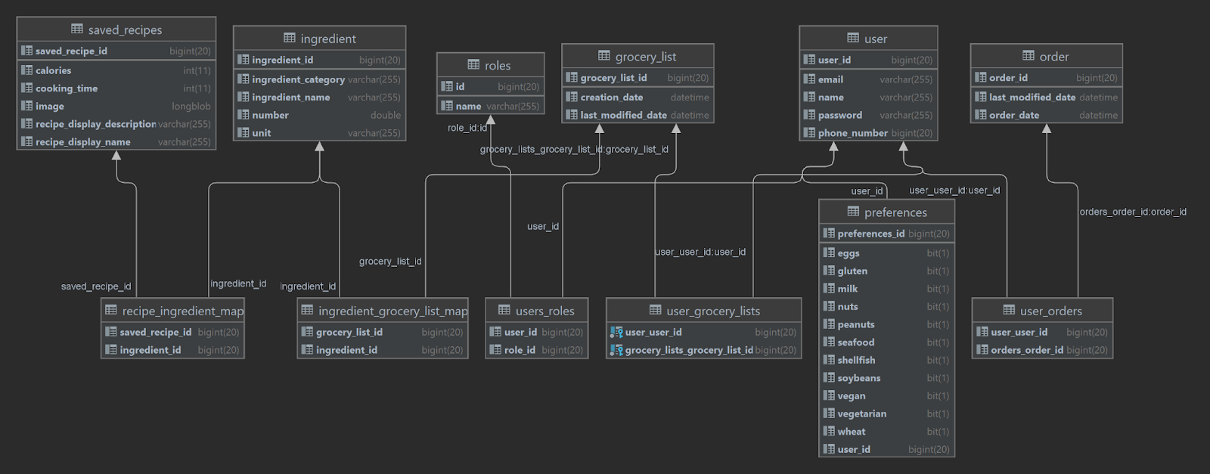
Database Design continued
Notes:
We are defining the relationships using Hibernate and it creates the tables in the database as shown in the diagram.

Slide 7
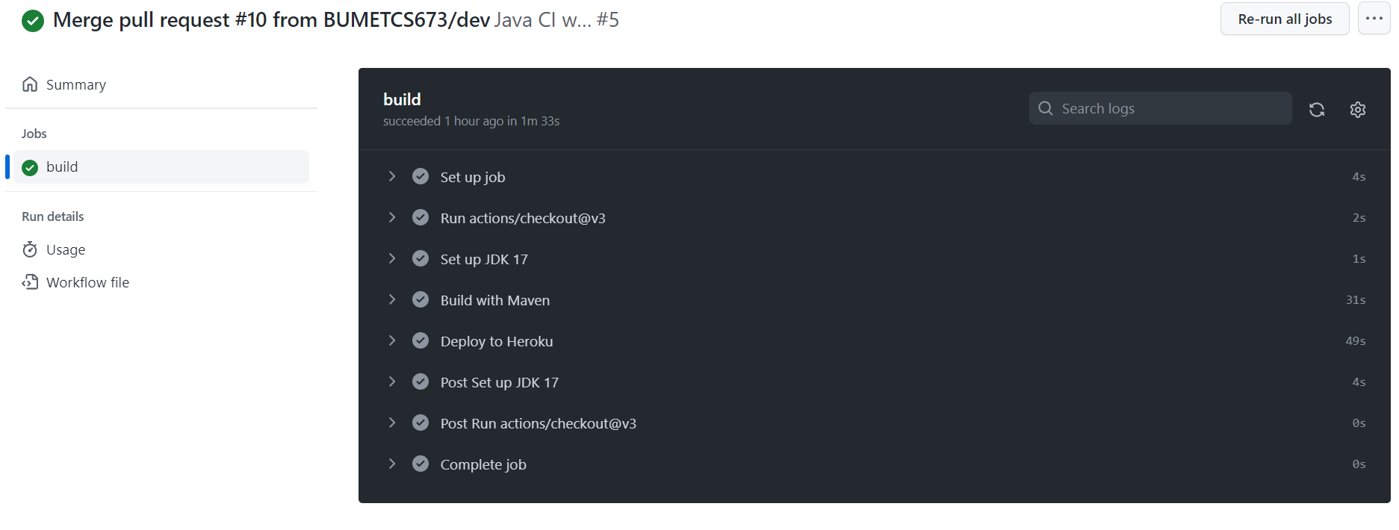
Deployment
Notes:
Github action for deploying to heroku. We have separate workflow when someone creates a PR to the dev or main branch. This will run mvn clean install which will catch any compile errors or failing tests.

Slide 8
Demo

Slide 9
Questions ?

